Slide 1
Data Visualization Project
Vishal Goyal
Human Life Expectancy Visualization(Tableau)

Slide 2
Human Life Expectancy Dataset Overview
The dataset related to life expectancy, health factors for 193 countries(2000-2015 year) has been collected from the same WHO data repository website and its corresponding economic data was collected from United Nation website.
This dataset consists of 22 Columns and 2938 rows which meant 20 predicting variables.
All predicting variables was then divided into several broad categories:​Immunization related factors, Mortality factors, Economical factors and Social factors.
Dataset link: https://www.kaggle.com/augustus0498/life-expectancy-who

Slide 3
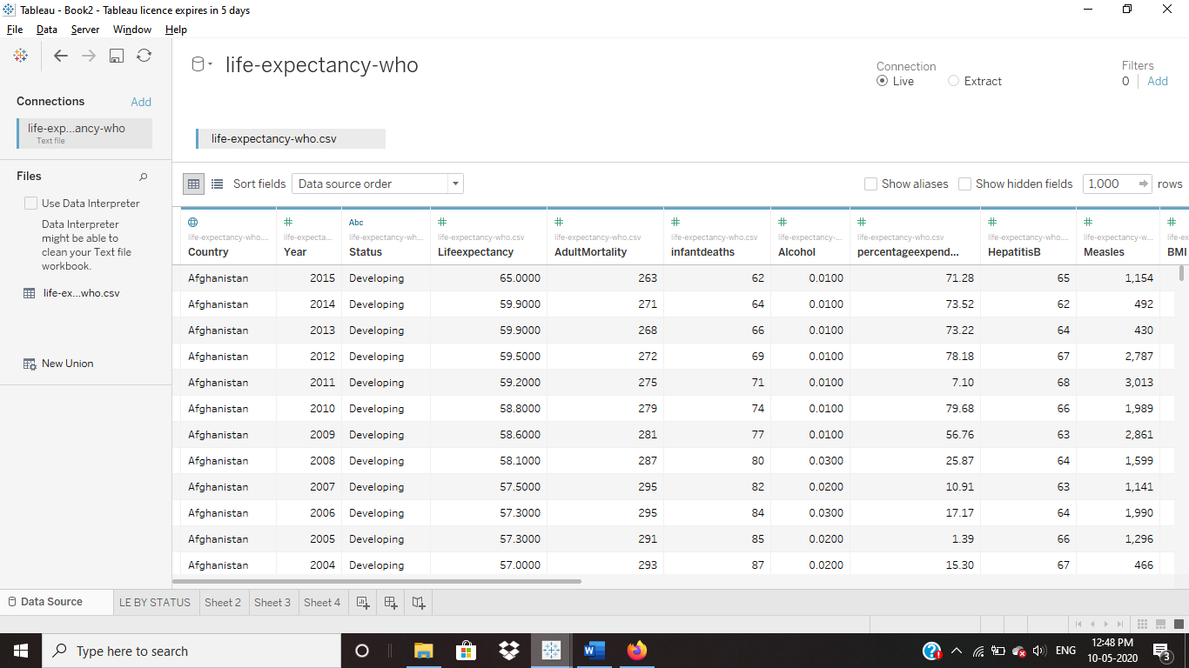
Dataset Table Picture

Slide 4
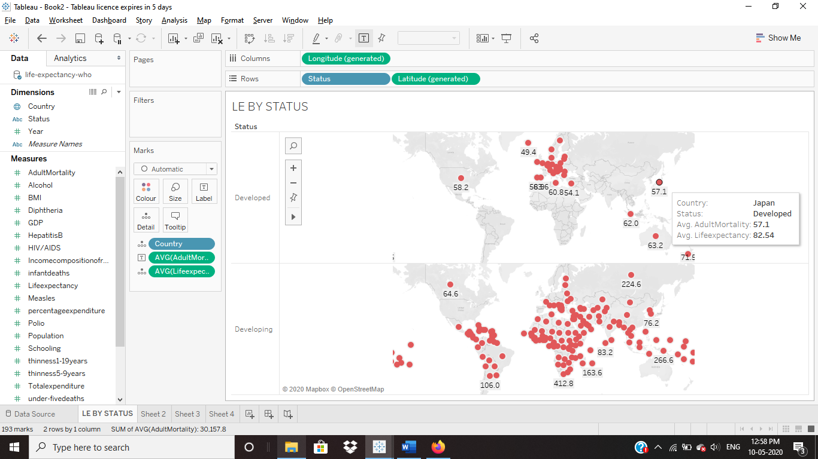
Does Life expectancy and mortality rate is affected by our lifestyle?

Slide 5
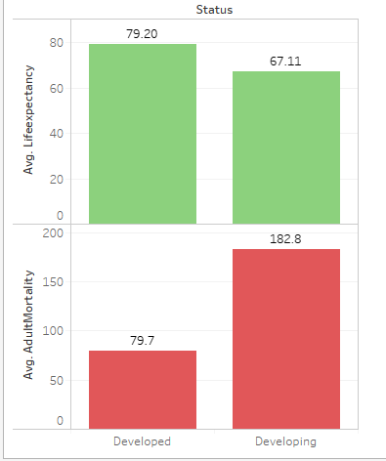
Shocking Results:
When We saw Life Expectancy and mortality rate per 1000 persons, results were shocking as shown in graphs.
Developed Countries has Good average Life expectancy compared to developing countries.
Mortality rate is also less in developed countries.
This means life style of developed countries needs to be followed by other countries.
Countries having a lower life expectancy value(<65) increase its healthcare expenditure in order to improve its average lifespan.

Slide 6
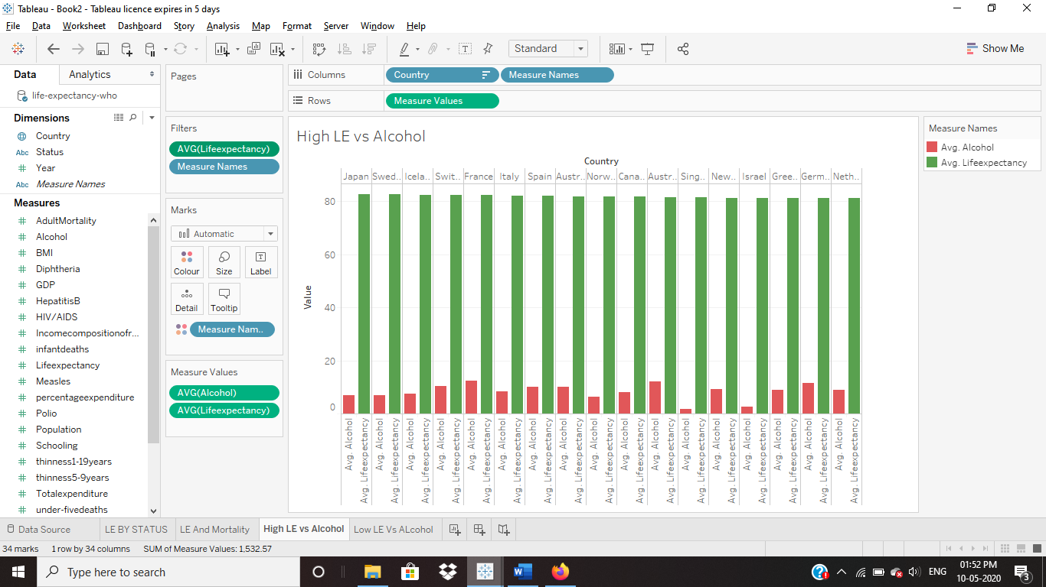
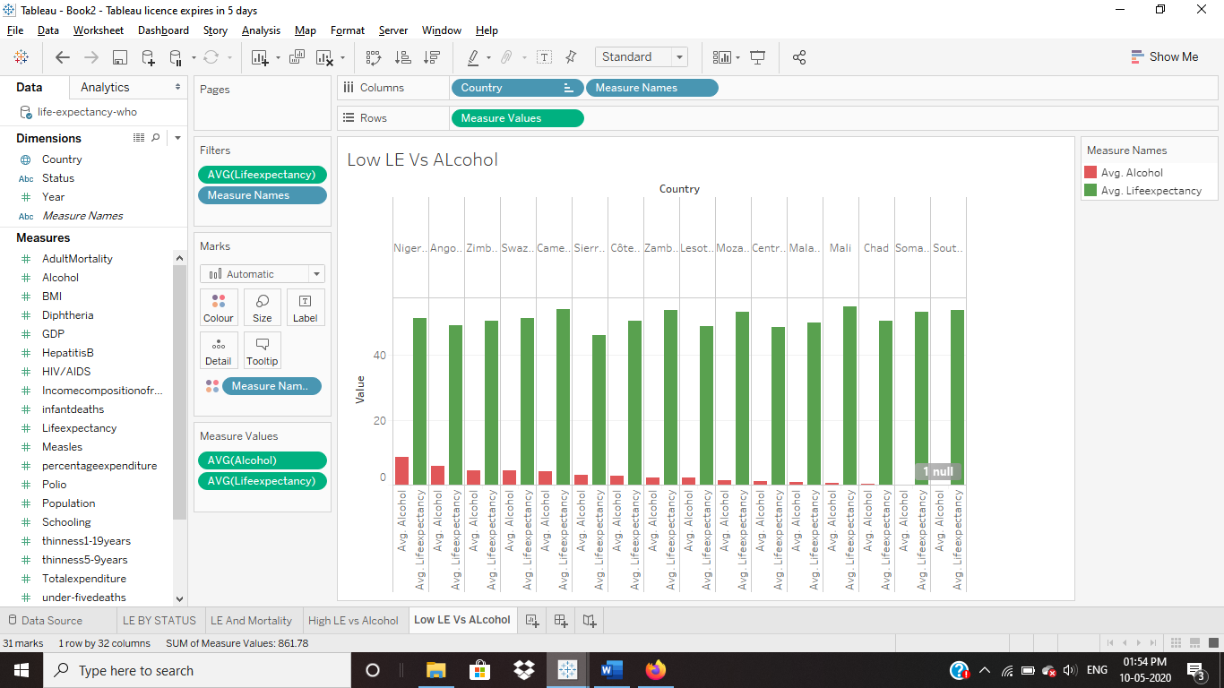
Does Life Expectancy has positive or negative correlation with eating habits, lifestyle, smoking, drinking alcohol etc. ?

Slide 7
LIfe expectancy VS Alcohol consumption:
Graphs shows High Life Expectancy above average 81 years and Low Life Expectancy below 55 years Vs Alcohol recorded per capita (15+) consumption (in litres of pure alcohol).
As shown in graph results are unexpected as there is most of the countries have higher alcohol consumption as compared to low life expectancy than countries with higher life span, also it proves that most of the countries are developed countries which have higher alcohol consumption.
Still after looking at graphs it also shows most of the countries do have higher consumption of alcohol with higher life span but it shows mixed results, probably alcohol consumption is not affecting life span that much after all.

Slide 8
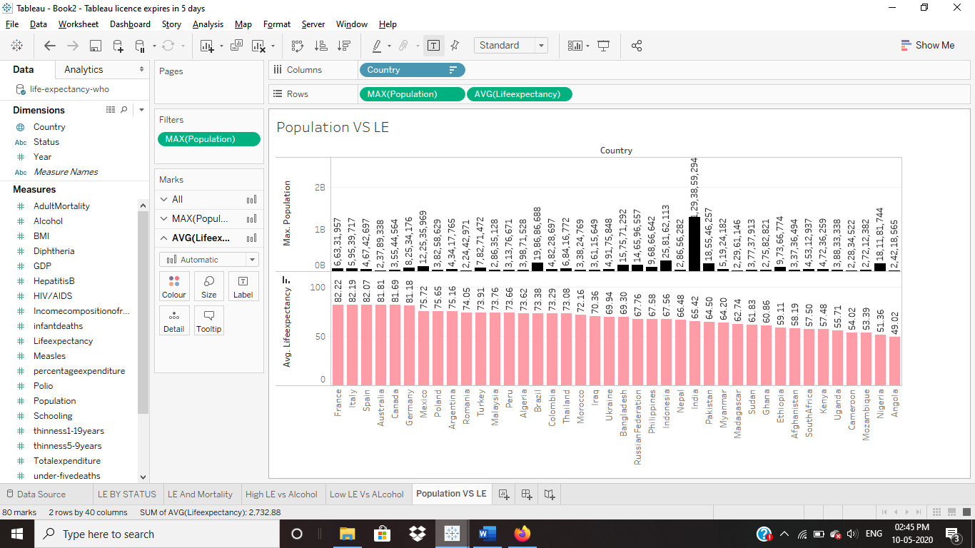
Do densely populated countries tend to have lower life expectancy?

Slide 9
Question needs to be answered.
Graph is plotted for average life expectancy and maximum population of the countries for analysis.
After looking at the graph it seems population is making no effect on life expectancy of human beings.
This means as developed countries have higher life span, so it doesn’t matter how populated county is instead it matters on the lifestyle of humans.
Developed countries with required technologies and good life annual income is affecting life spans more.

Slide 10
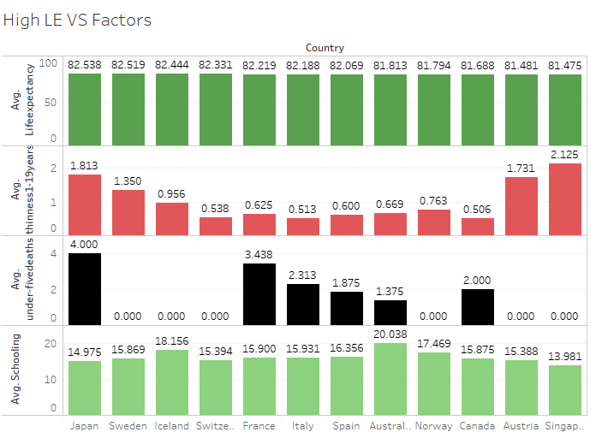
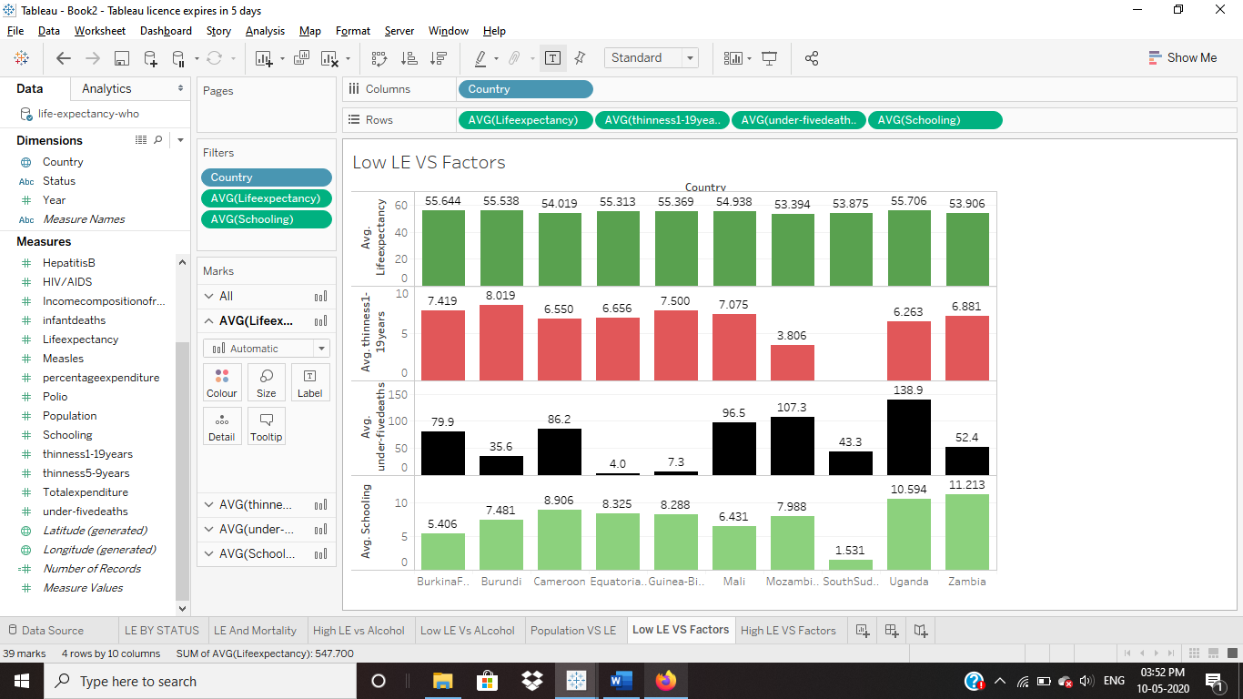
What are the predicting variables actually affecting the life expectancy?
1)Schooling 2)Infant Deaths 3)Body Thinness

Slide 11
What factors really showing difference of high and low life expectancy of countries..
As two graph shows life expectancy shows great difference in following factors- Schooling years,Number of under-five infant deaths per 1000 population and Prevalence of thinness among children and adolescents for Age 10 to 19(%)
Education is at very higher rate in good life span countries.
Infant deaths are very less in countries where life span is higher this means medical availability is higher in this regions, development is affecting this factors.
Might be poverty is causing thinness of children and adolescents which is affecting life span.

Slide 12
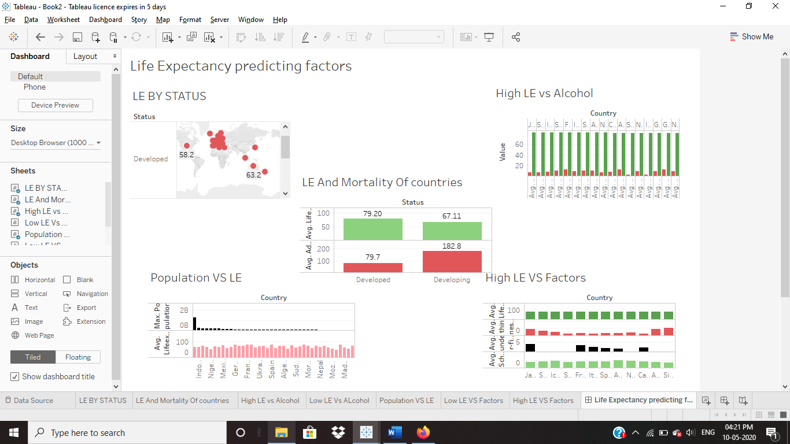
Dashboard Overview

Slide 13
Conclusion:
After looking at all the factors affecting over the time it seems development in economy is helping in increasing life expectancy.
Economy growth is helping in education and medical availability which is directly affecting life span.
Developed countries lifestyle is making good impact on life expectancy after all.

Slide 14
Thank You

